Slide 1
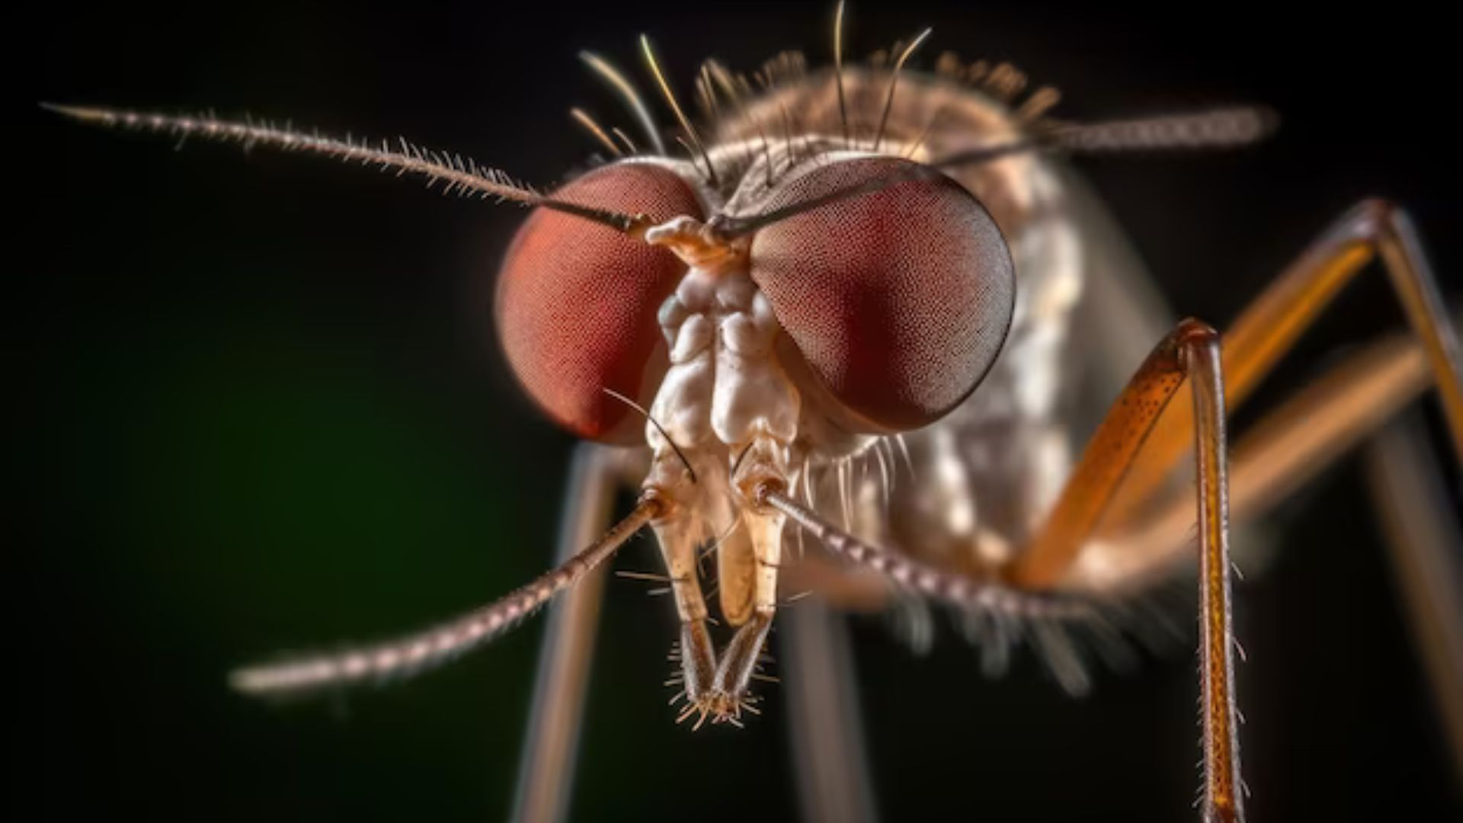
Mosquito & Vector Control
In Orange County
Brian Brannon
Public Information Officer
Orange County Mosquito and
Vector Control District
Notes:
One of two Independent special district in OC. 34 City Trustees, 1 County Trustee. Second largest board in state.

Slide 2
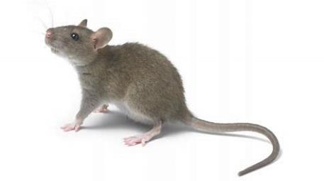
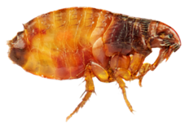
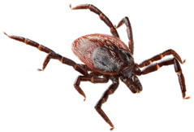
Our Mission
To educate and protect the people of Orange County
from vectors and prevent vector-borne diseases in an environmentally responsible manner.
Notes:
RSM Inspector Christian Herold

Slide 3
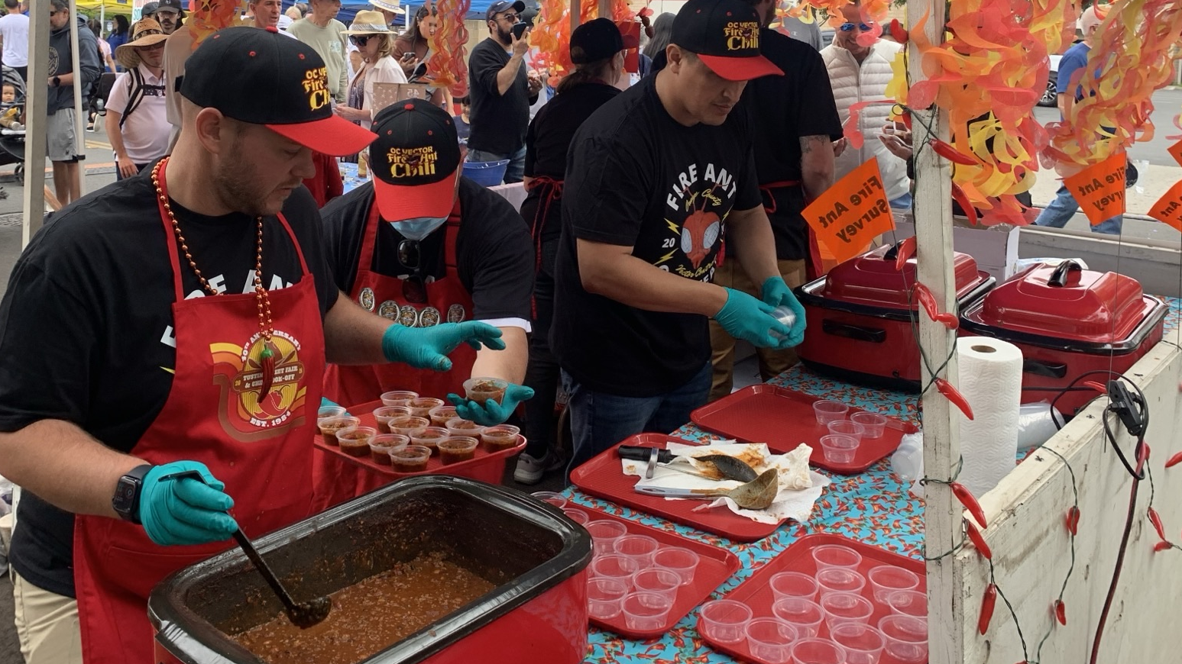

What We Do
Notes:
Largest one day chili cook-off in the US. Education: Partnerships, presentations, customer service, school programs, outreach, literature, online information, traditional and social media

Slide 4
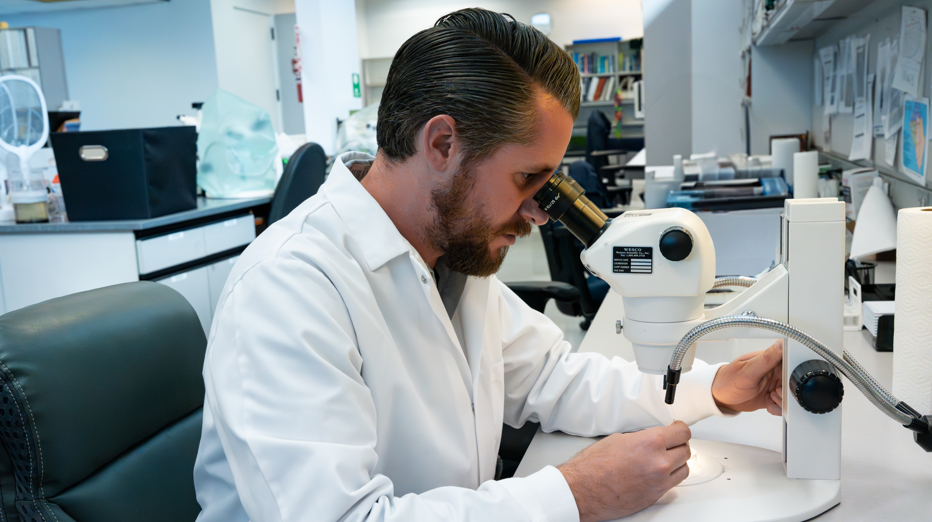
What We Do
Notes:
Surveillance: Abundance monitoring and testing for pathogens in mosquitoes, ticks, fleas, rodents, birds, and opossums

Slide 5
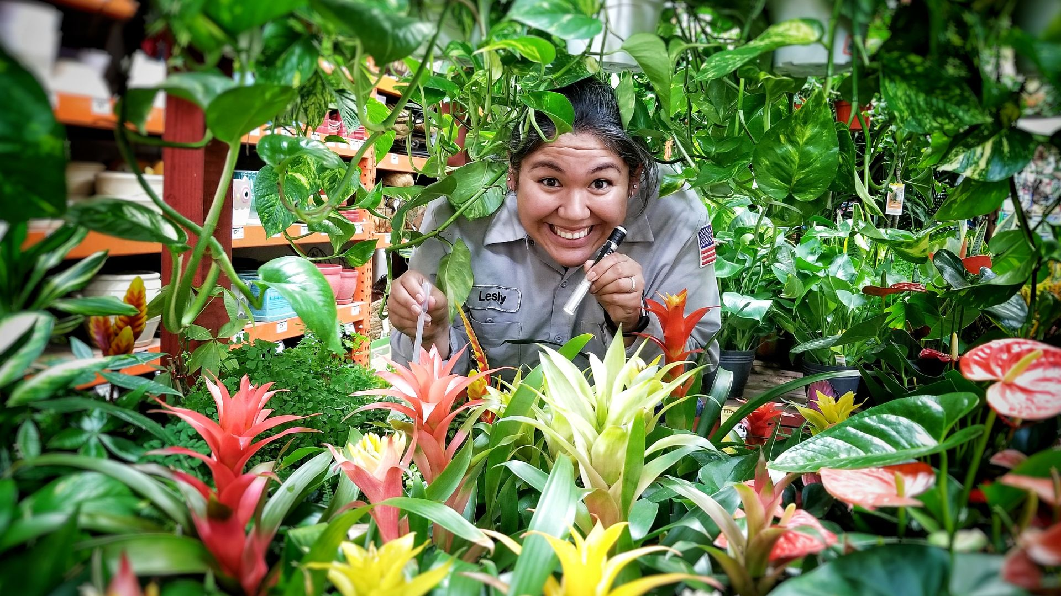
What We Do
Notes:
Bromeliads --- Control of mosquitoes, RIFA, rats, filth flies
Source reduction – eliminate breeding
Biological control – mosquitofish
Chemical control – larvicide, adulticide

Slide 6
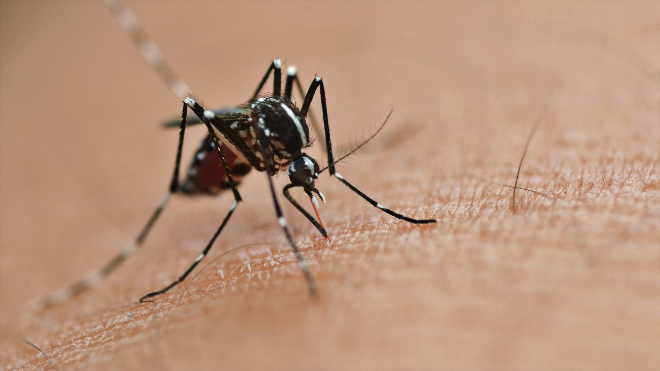
Aedes Mosquitoes
Notes:
Zika, Dengue, Chikungunya, Yellow Fever, Dog Heartworm – 16 cases of local transmission in CA last year – 10 cases of travel related in LA this year alone

Slide 7
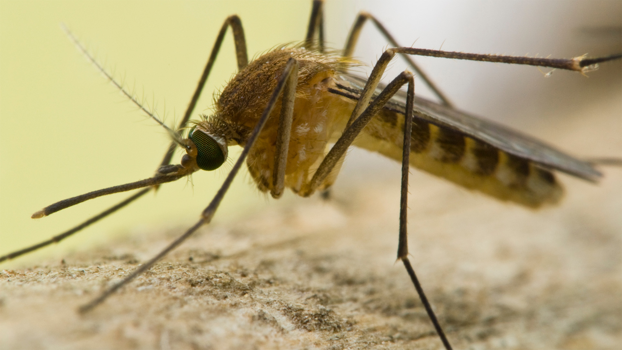
Culex Mosquitoes
Notes:
Culex quiquefasciatus shown. West Nile virus, St. Louis Encephalitis, Western Equine Encephalitis. WNV most serious and most common vector-borne disease in CA. 8,000 human cases and nearly 400 deaths reported in California since 2003

Slide 8


Slide 9
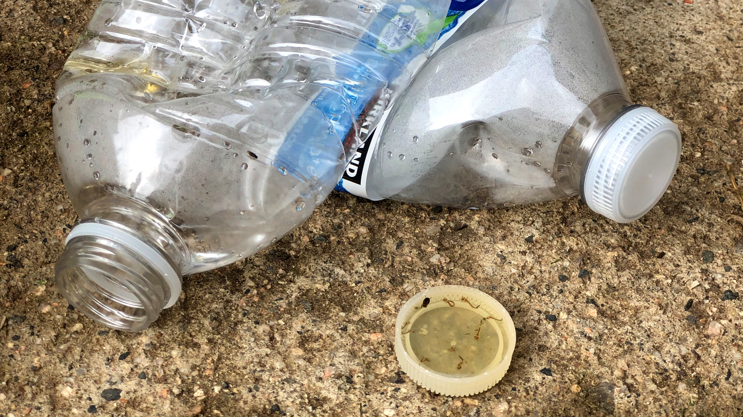
Mosquito breeding sources

Slide 10
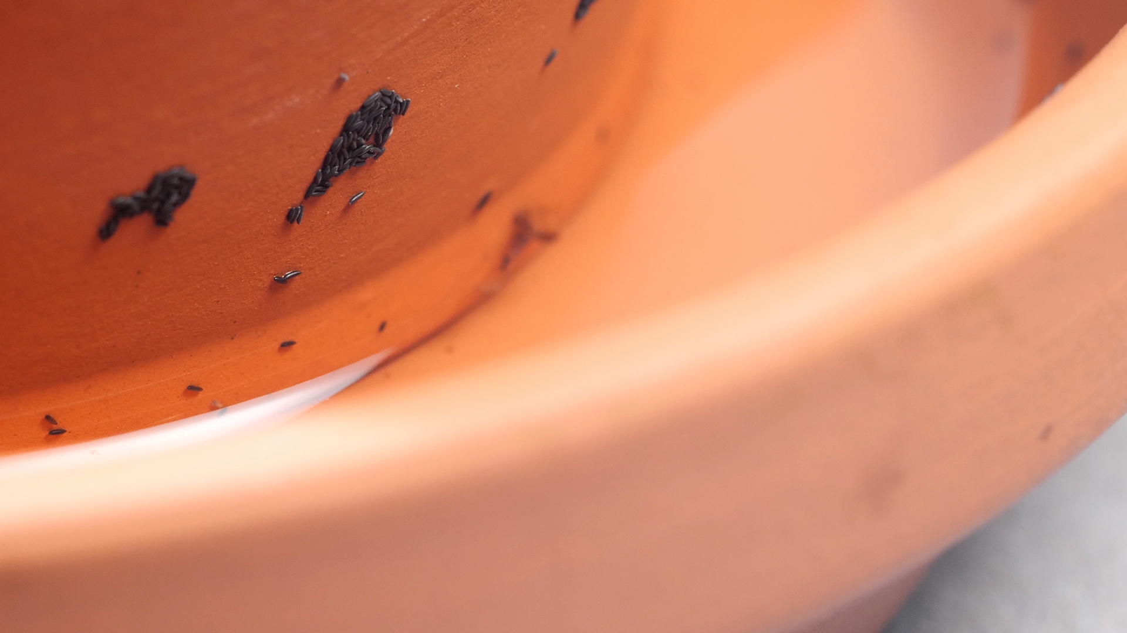
Mosquito breeding sources

Slide 11
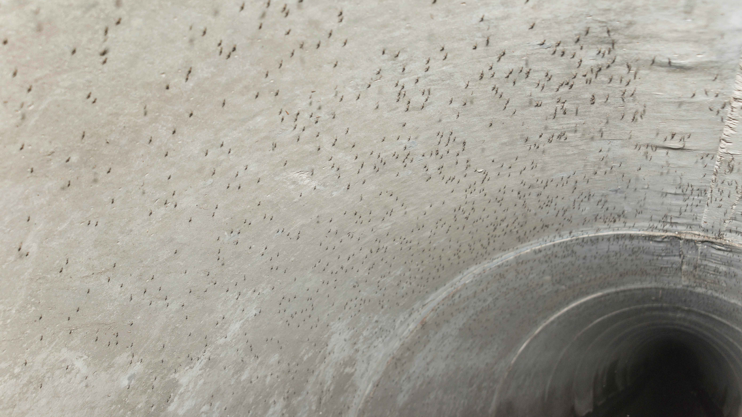
Mosquito breeding sources
Notes:
Culex quinquefasciatus (southern house mosquito): St. Louis encephalitis, Western equine encephalitis, Zika and West Nile

Slide 12
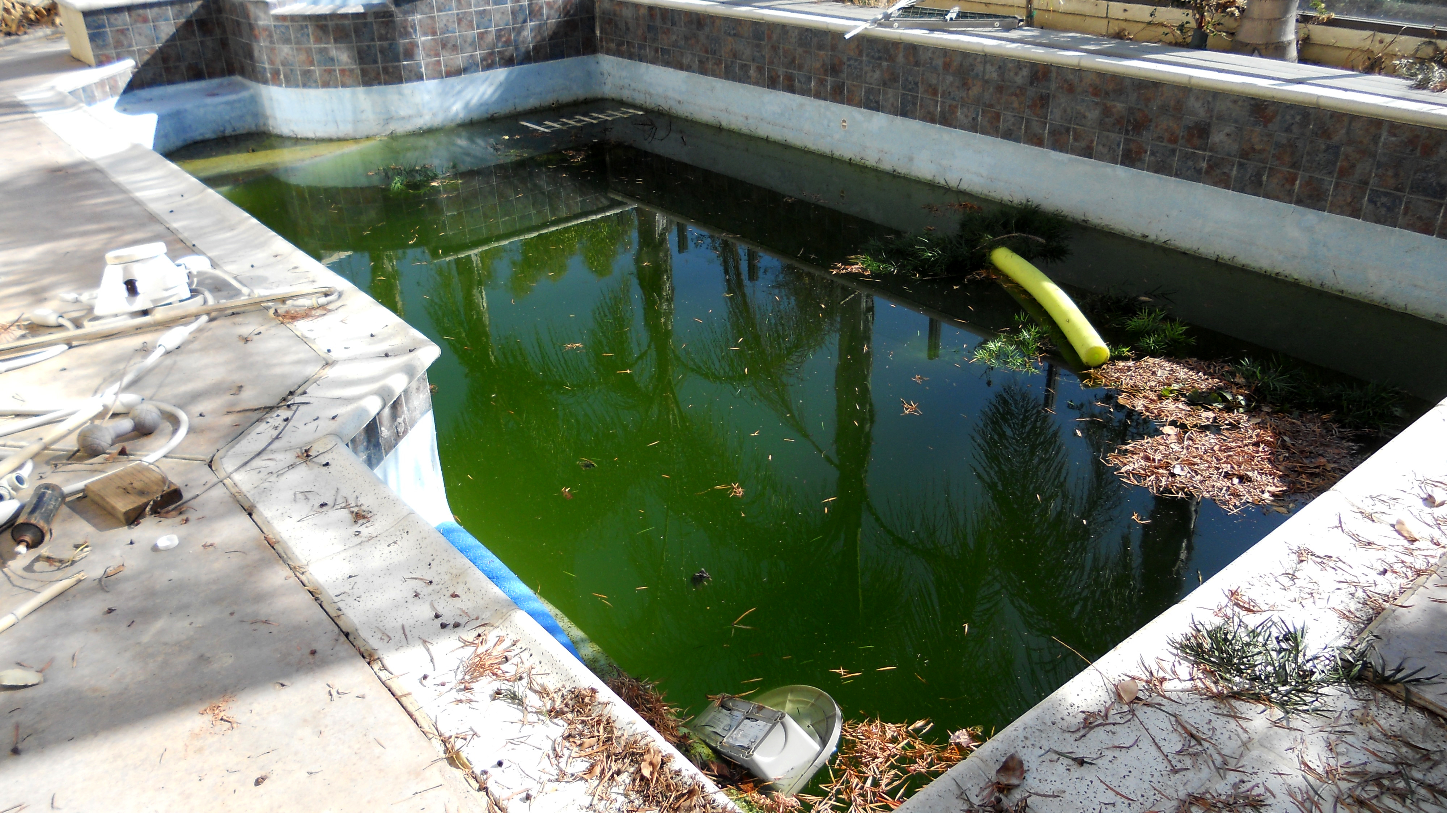
Mosquito breeding sources
Notes:
Can anyone guess how many mosquitoes we recently found in one pool? 300,000

Slide 13
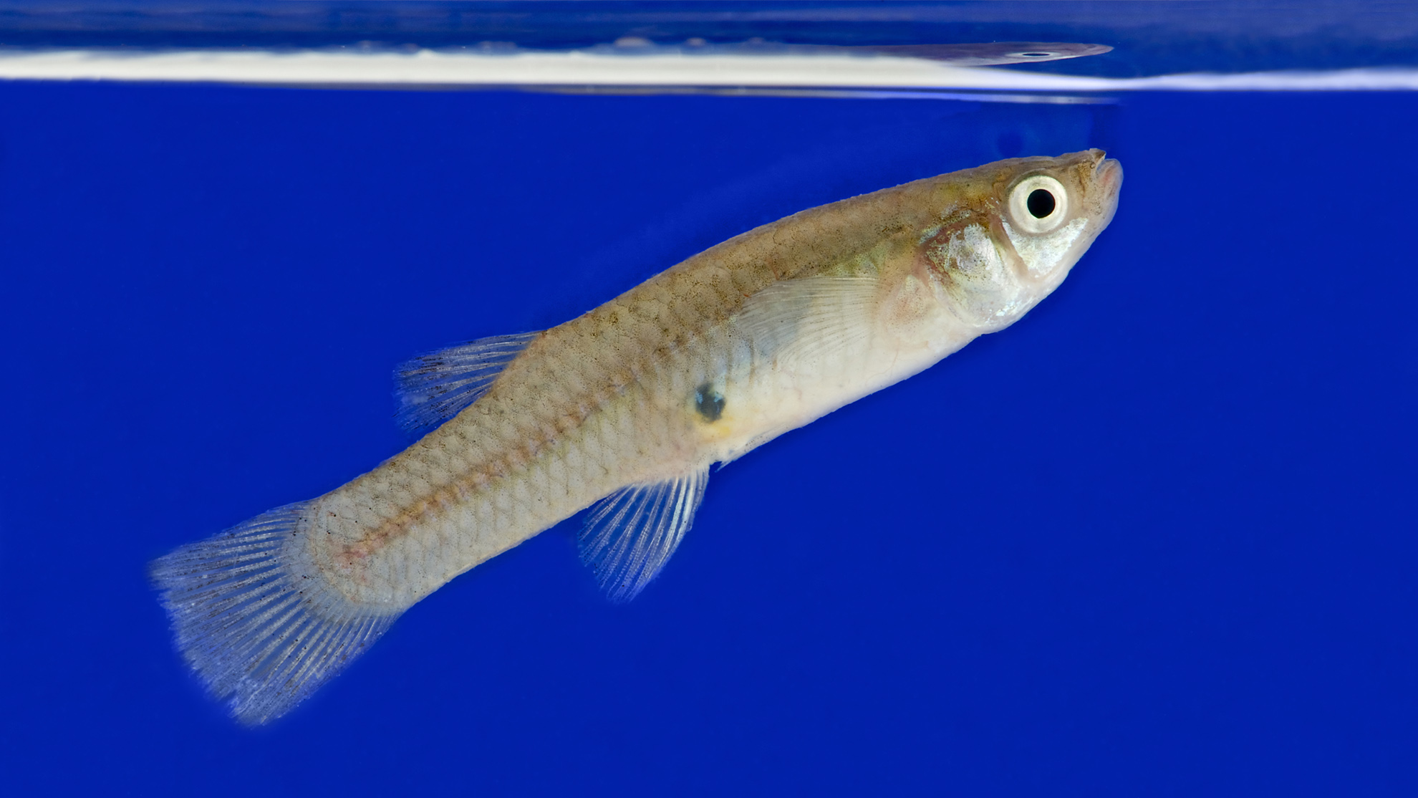
Mosquitofish
Notes:
Gambusia affinis. Non-native, invasive.

Slide 14
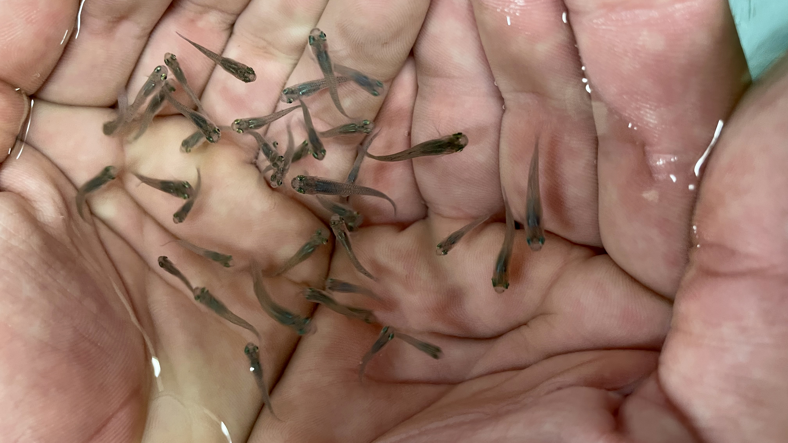
Mosquitofish
Notes:
Ponds on site. Tortilla holders perfect size for inspectors to take out to residents. These fish may look small…

Slide 15
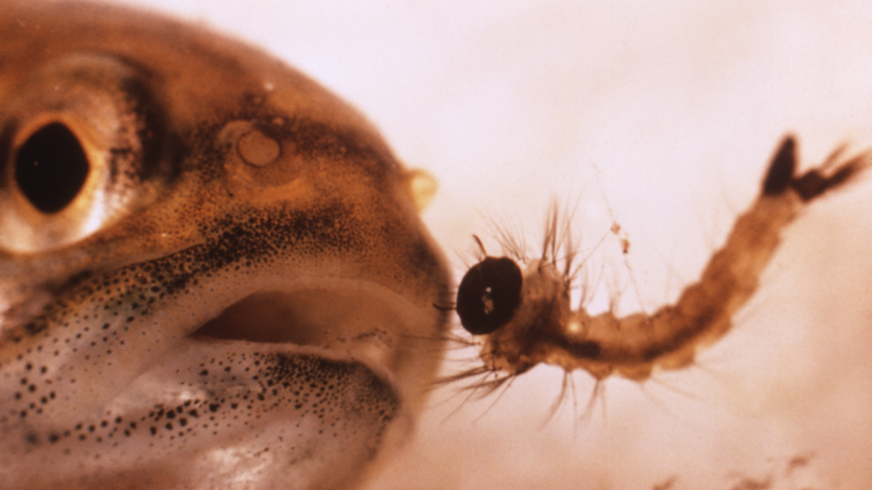
Mosquitofish
Notes:
But not to the mosquito larvae.

Slide 16
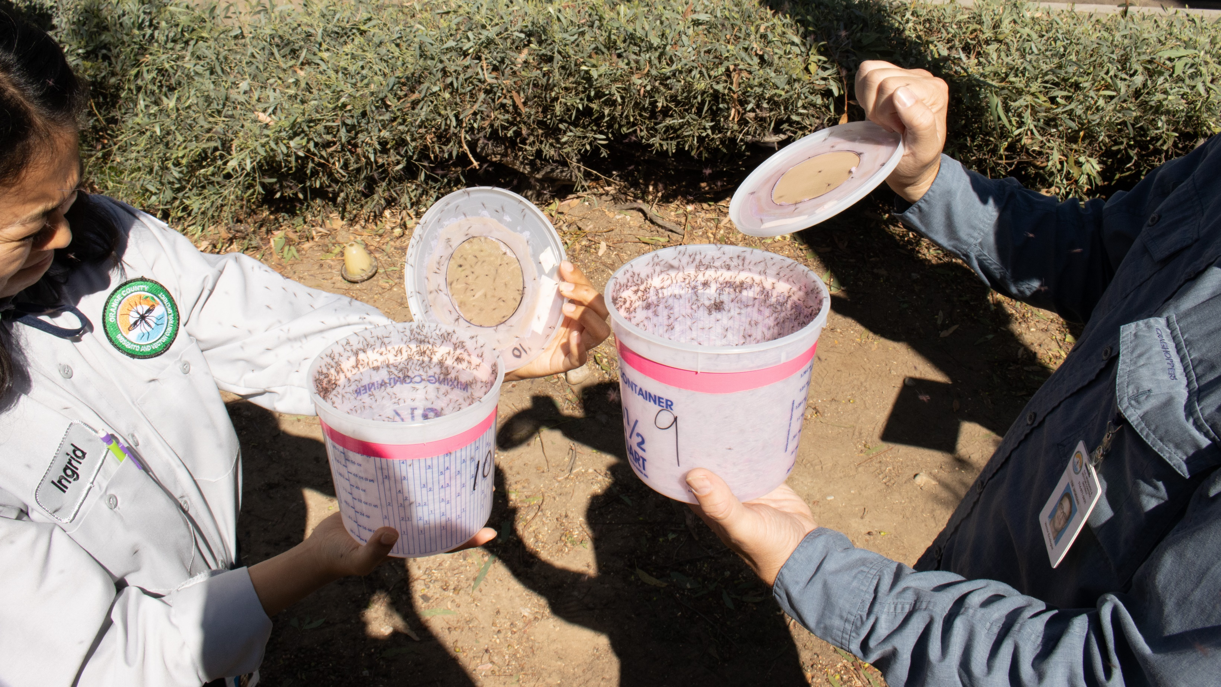
Sterile Insect Technique (SIT)
Notes:
Operational release in late May — Kelly Tokarski Mission Viejo PIO

Slide 17
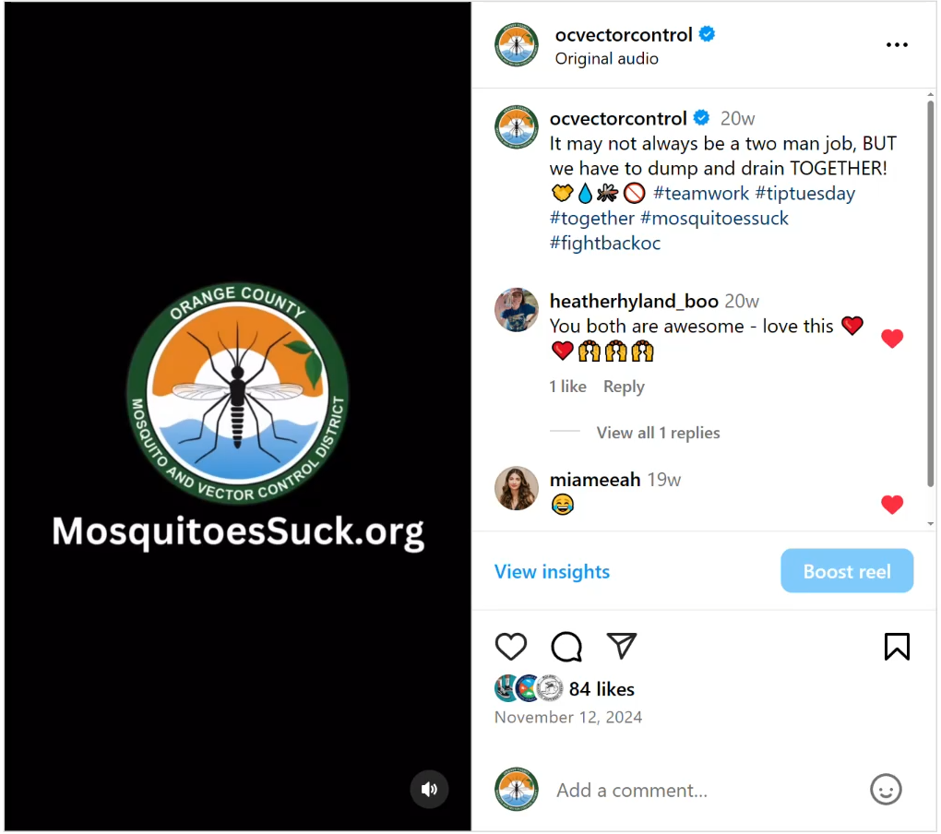
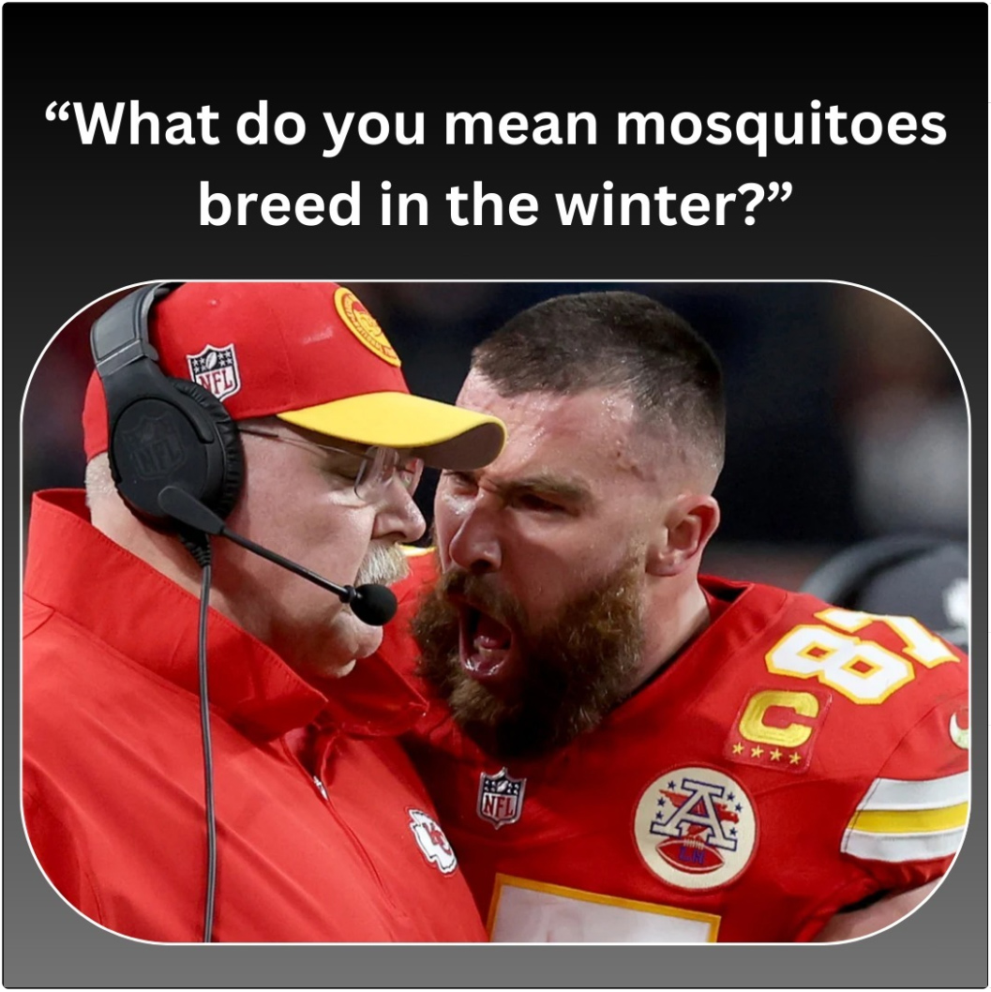
Social Media
Notes:
As you can see here, Travis Kelse is no fan of mosquitoes.

Slide 18
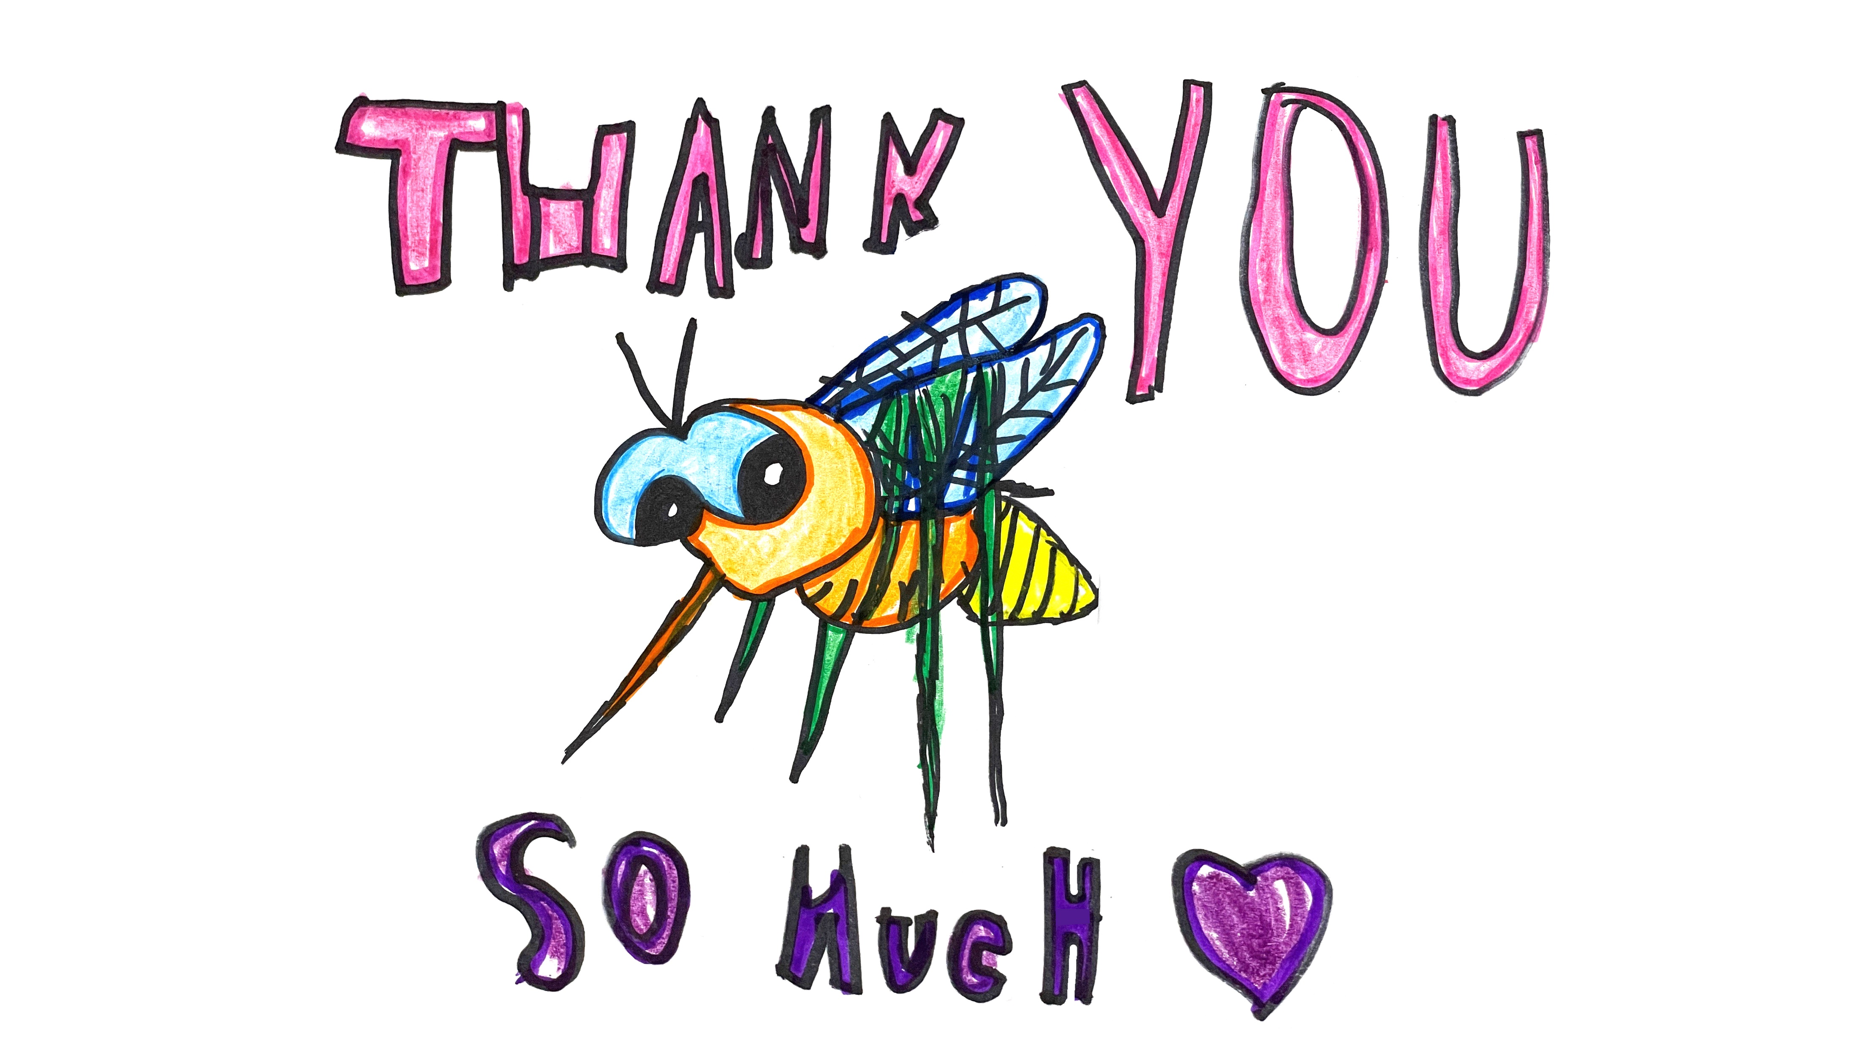
bbrannon@ocvector.org
www.ocvector.org
Social media @ocvector
Customer service line:
(714) 971-2421

